Slide 1
Lung Ultrasound Basic Techniques for rapid evaluation of dyspnea
Adam Flynn, MD
Facharzt für Innere Medizin
Board Certified American board of family medicine

Slide 2
Introduction
Lung ultrasound (technically pleural ultrasound) is a technique for detecting pathologies not traditionally thought to be visible to ultrasound, including:
Pulmonary edema
Pneumonia
Atelectesis
Pneumothorax

Slide 3
Goals
Learn the appropriate technique, probe and orientation
Identify normal findings
Identify pathological findings
Pneumonia
Pulmonary Edema
Assimilate findings to suggest a diagnosis

Slide 4
Why wouldn't we ultrasound the lungs???
Air is the ENEMY of ultrasound!
And lungs are full of air!

Slide 5
What can you see?
Fluid Collections
Pleural Line
Consolidated Lung
Artefacts from the pleura
The key is that the artefacts have meaning!

Slide 6
Landmarks
When we place a probe over the lungs, what can we see?
Ribs
Pleural Line
Maybe Diaphragm + Liver / Spleen
Artefacts

Slide 7
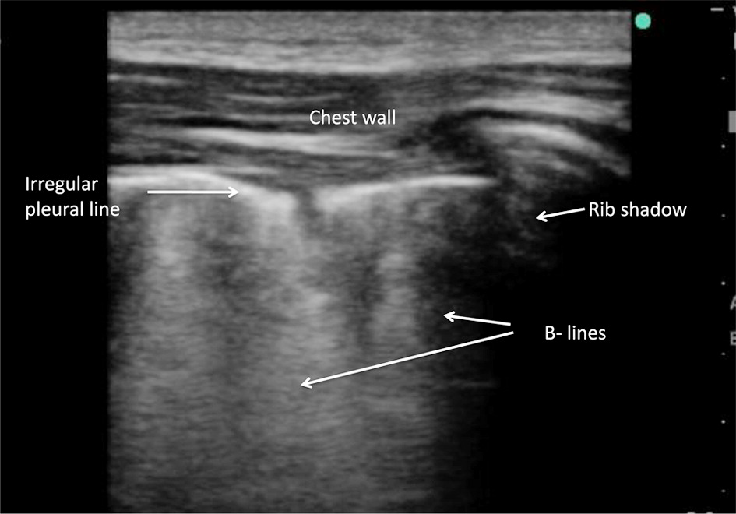
Landmarks
Pleural Line
Should be smooth
Irregularity is pathologic!

Slide 8
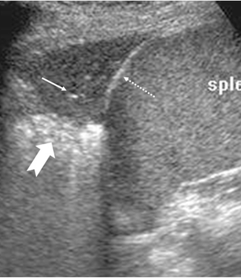
Find the Liver and Speen

Slide 9
Lung Sliding
Movement between the two layers of the pleura can be observed
'Ants on a Log'

Slide 10
Curtain Sign
Inhalation should cause the lung to cover the diaphragm or spleen
Great way to evaluate for a tiny effusion or lower lobe consolidation

Slide 11
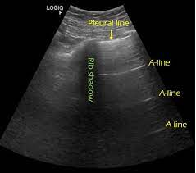
What are A-Lines?
Normal reverberation artefact
Indicates that the pleura is DRY
Your probe has to be perpendicular to the pleura to see A-lines

Slide 12
B-Lines
'Meteorismus'
Vertical extensions from the pleura to the bottom of the screen
Destroy A-Lines
Indicate the pleura is wet

Slide 13
Patterns of B-Lines
Isolated
Consolidating B-Lines

Slide 14
Consolidated Lung
Lung Hepatization
Shred Sign
Air Bronchograms

Slide 15
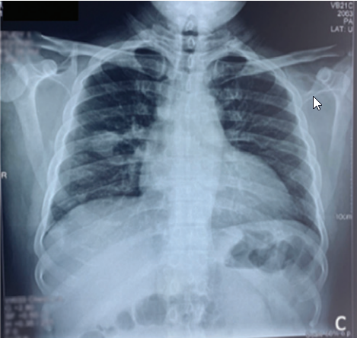
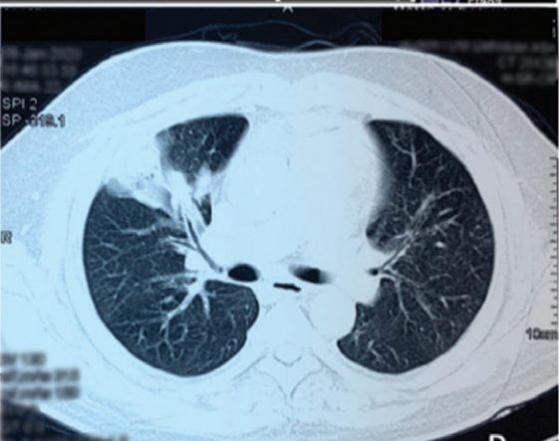
Pneumonia
Comparison

Slide 16
What Probe to Use?
Whichever one gets through the soft tissue!
Less artefact-suppression is better
Many machines have a Lung setting

Slide 17
Where to Examine
Posterior as well if patient can roll or sit up (R5,6, L5,6)

Slide 18
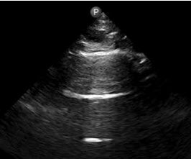
Patterns of Disease
A-Line Profile
COPD / Asthma
Pulmonary Embolism
Pneumothorax?

Slide 19
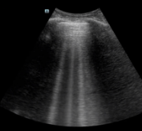
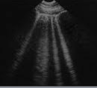
Patterns of Disease
B-Line Profile, Diffuse
Pulmonary Edema
Recognizable earlier than with X-ray!

Slide 20
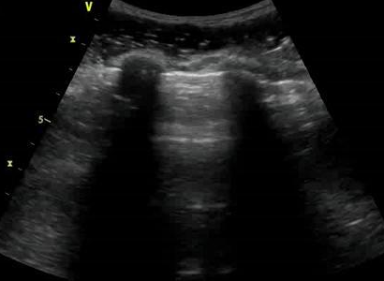
Patterns of Disease

Slide 21
Patterns of Disease
Focal B-Line Pattern
Pneumonia
Other focal interstitial diseases

Slide 22
How good is Lung Ultrasound?
For pulmonary edema:
Sensitivity: 97%
Specificity: 98%
A negative study virtually excludes pulmonary edema
Comparison to Chest X-ray
60-65% sensitivity
Negative predictive value: 55-60%

Slide 23
How good is Lung Ultrasound?
Pneumonia
Comparison with 2-View, Standing Chest Xray (CT as Standard)
US: Sensitivity 90-95%
2-view X-ray: 50-80%
Supine X-ray?
Estimated sensitivity: Right – 45% Left – 38%

Slide 24
Summary
This is a good technique for:
Dividing dyspnea into big categories
Identifying infiltrates that would otherwise not be seen
Early recognition of pulmonary edema
How to learn?
Practice and compare!

Slide 25
References
Wang Y, Shen Z, Lu X, Zhen Y, Li H. Sensitivity and specificity of ultrasound for the diagnosis of acute pulmonary edema: a systematic review and meta-analysis. Med Ultrason. 2018 Feb 4;1(1):32-36. doi: 10.11152/mu-1223. PMID: 29400365.
Al Deeb M, Barbic S, Featherstone R, Dankoff J, Barbic D. Point-of-care ultrasonography for the diagnosis of acute cardiogenic pulmonary edema in patients presenting with acute dyspnea: a systematic review and meta-analysis. Acad Emerg Med. 2014 Aug;21(8):843-52. doi: 10.1111/acem.12435. PMID: 25176151.
Ghauri SK, Mustafa KJ, Javaeed A, Khan AS. Accuracy of lung ultrasound and chest X-rays in diagnosing acute pulmonary oedema in patients presenting with acute dyspnoea in emergency department. J Pak Med Assoc. 2021 Oct;71(10):2423-2425. doi: 10.47391/JPMA.03-453. PMID: 34974583.
Bedside Ultrasound Versus Chest Radiography for Detection of Pulmonary Edema: A Prospective Cohort Study William M. Wooten DO, Lynn E. T. Shaffer PhD, Lisa A. Hamilton MD
Kunz WG, Patzig M, Crispin A, Stahl R, Reiser MF, Notohamiprodjo M. The Value of Supine Chest X-Ray in the Diagnosis of Pneumonia in the Basal Lung Zones. Acad Radiol. 2018 Oct;25(10):1252-1256. doi: 10.1016/j.acra.2018.01.027. Epub 2018 Mar 2. PMID: 29506819.
D. Lichtenstein G. Mezire A lung ultrasound sign allowing bedside distinction between pulmonary edema and COPD: the comet-tail artifact Intensive Care Med (1998) 24: 1331±1334

